Slide 1
Introduction to REST API in iOS
CS590BD: Big Data Analytics and Apps

Slide 2
REST SERVICES
REST - Representational State Transfer
Communicates over HTTP Protocol using http verbs such as GET, PUT, POST , DELETE etc.

Slide 3
Example for REST Service: Google Map Service
Search supports the q parameter.​
q: The query string for your search.​
An example URL is below to search for “Pizza” around the specified location:​
https://maps.google.com/?q=Pizza&center=37.759748,-122.427135

Slide 4
NLP REST Service
NLP - Natural Language Processing
REST API: http://nlpservices.mybluemix.net/api/service/chunks/How%20are%20you?
Red marked text is the sentence input

Slide 5
NLP REST Service
The API returns a JSON Object:
{
"chunks" : ["How","you"],
"tags" : ["WRB","VBP","PRP"],
"chunks2" : ["B-ADVP","O","B-NP"],
"tokens" : ["How","are","you"],
"sentence": "How are you"
}

Slide 6

Basic Natural Language Processing Techniques
POS (Part of Speech) Tagging:
Annotate each word in a sentence with a part-of-speech marker.
Lowest level of syntactic analysis.
Example:
Source: http://www.cs.utexas.edu/~mooney/cs388/slides/pos-tagging.ppt

Slide 7
Consuming REST Service in iOS
Using AFNetworking Library
AFNetworking Library is a networking library for iOS and Mac OS X .]
Documentation for AFNetworking Library: http://afnetworking.com

Slide 8
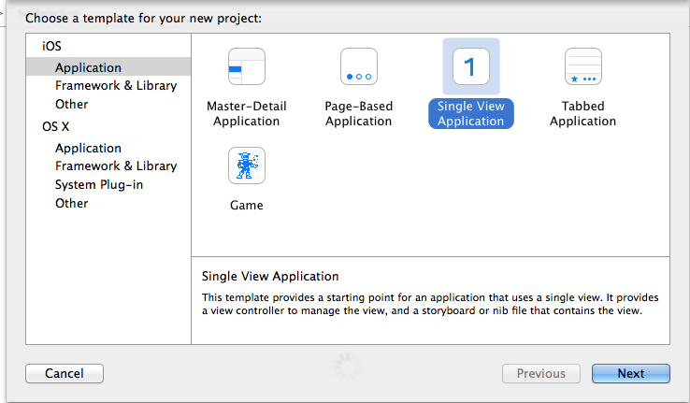
Step 1: Create a XCode Project
Create a Single View Application

Slide 9
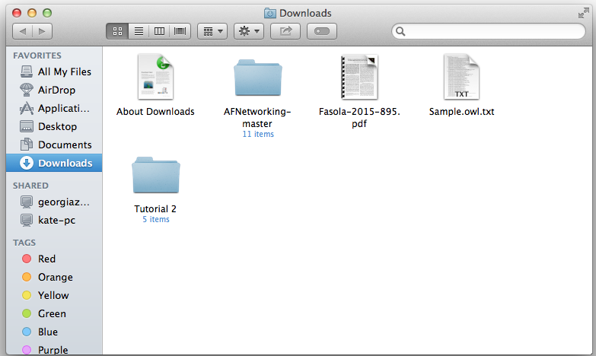
Step 2: Adding library to XCode
Download AFNetworking
AFNetworking-master folder gets downloaded

Slide 10
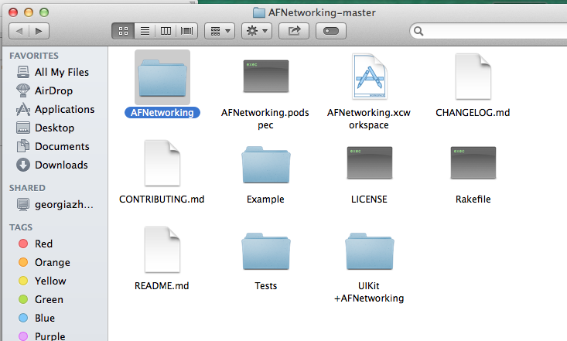
Step 2: Adding library to XCode
C. Drag and drop the AFNetworking folder inside AFNetworking-master

Slide 11
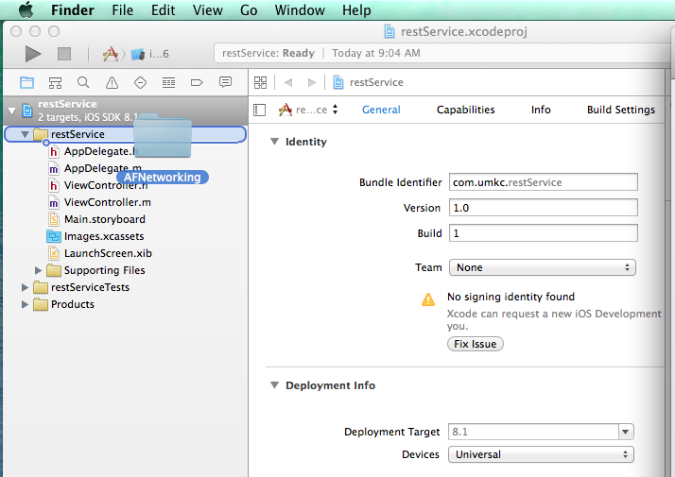
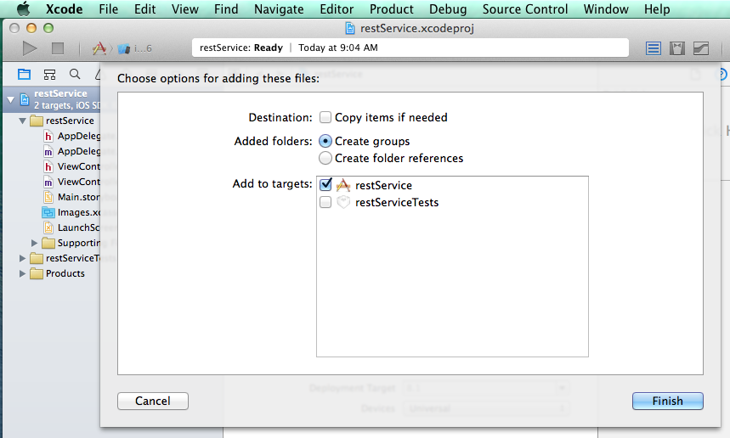
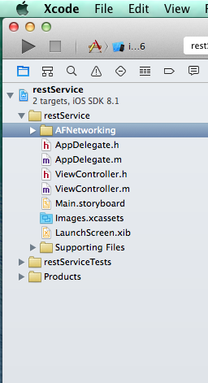
Step 2: Adding library to XCode

Slide 12
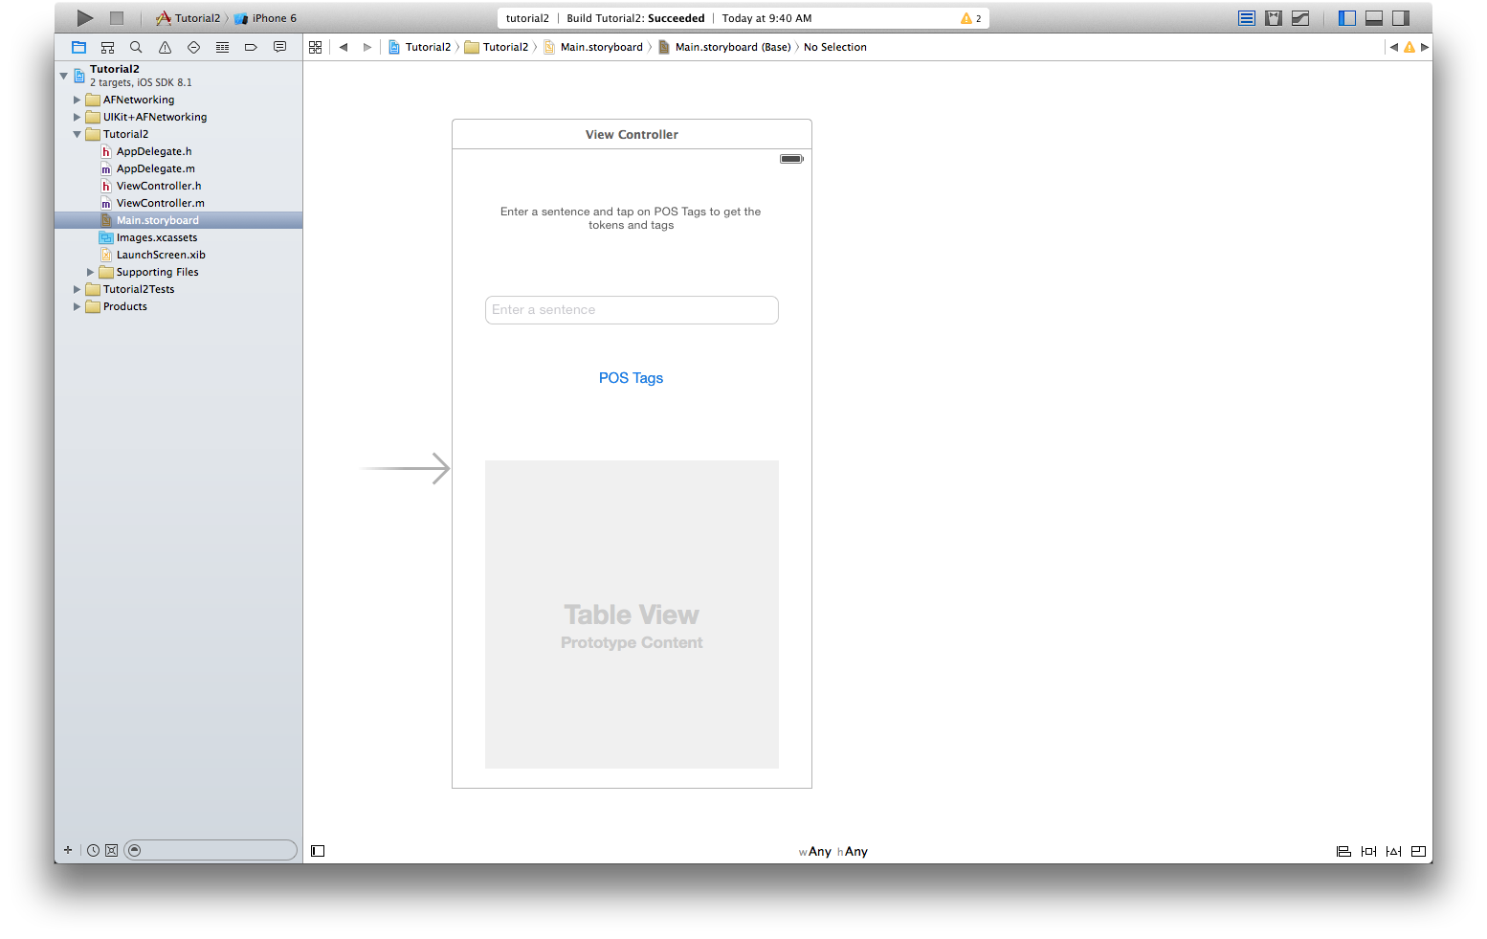
Step 3: Creating UI
Add TextField, Button and Table View.
Text Field -> For entering the sentence
Button -> To initiate the REST call
TableView -> For Results display

Slide 13
Step 4: REST Call
Importing AND Global Variable Declaration
#import "AFHTTPRequestOperationManager.h"
#define BASE_URL "http://nlpservices.mybluemix.net/api/service"

Slide 14
Step 4: REST Call in Button (Touch up Inside Event)
To call the REST service first we should initiate a HTTPRequest manager.
AFHTTPRequestOperationManager *manager = [AFHTTPRequestOperationManager manager];
Parameter URL encoding.
NSString *sentense = [_sentenceTextField.text stringByAddingPercentEncodingWithAllowedCharacters:[NSCharacterSet URLQueryAllowedCharacterSet]];
NSString *url = [NSString stringWithFormat:@"%s/chunks/%@", BASE_URL, sentense];

Slide 15
Step 4: REST Call in Button (Touch up Inside Event)
Response from the service
HTTP GET operation execution.
[manager GET:url parameters:nil success:^(AFHTTPRequestOperation *operation, id responseObject) {
NSLog(@"JSON: %@", responseObject);
} failure:^(AFHTTPRequestOperation *operation, NSError *error) {
NSLog(@"Error: %@", error);
UIAlertView *alert = [[UIAlertView alloc] initWithTitle:@"Error"
message:[error description]
delegate:nil
cancelButtonTitle:@"Ok"
otherButtonTitles:nil, nil];
[alert show];
}];

Slide 16
Step 4: REST Call in Button (Touch up Inside Event)
Parsing the response.
_tokens = [responseObject objectForKey:@"tokens"];
_tags = [responseObject objectForKey:@"tags"];
Using the parsed data in UITableview.
- (UITableViewCell *)tableView:(UITableView *)tableView cellForRowAtIndexPath:(NSIndexPath *)indexPath {
static NSString *cellIdentifier = @"Cell";
UITableViewCell *cell = [tableView dequeueReusableCellWithIdentifier:cellIdentifier];
if(cell == nil) {
cell = [[UITableViewCell alloc] initWithStyle:UITableViewCellStyleValue1 reuseIdentifier:cellIdentifier];
}
cell.textLabel.text = [NSString stringWithFormat:@"%@", [_tokens objectAtIndex:indexPath.row]];
cell.detailTextLabel.text = [NSString stringWithFormat:@"%@", [_tags objectAtIndex:indexPath.row]];
return cell;
}

Slide 17
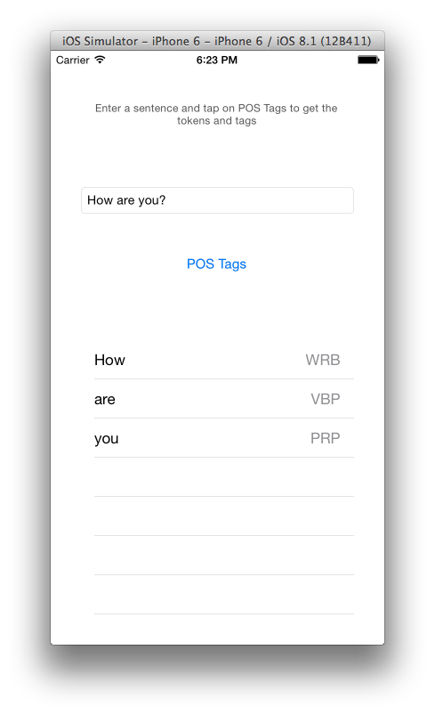
Step 5: Final Run

Slide 18
Instagram REST API
Retrieving image through Instagram API.
https://api.instagram.com/v1/tags/puppy/media/recent?client_id=CLIENT-ID
Client-ID can be obtained by registering as developer in instagram
Documentation : https://instagram.com/developer/endpoints/

Slide 19
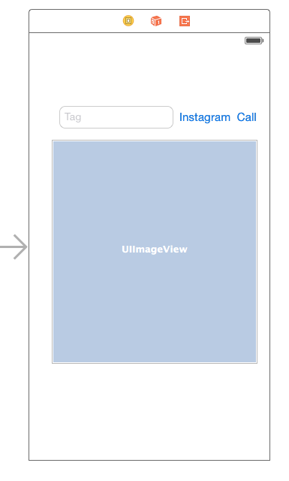
Step1 : Creating UI

Slide 20
Step 2: Instagram REST Call
Follow the steps explained in previous example.
Remember to check the JSON response to parse into it.
Useful Link :http://jsonmate.com

Slide 21
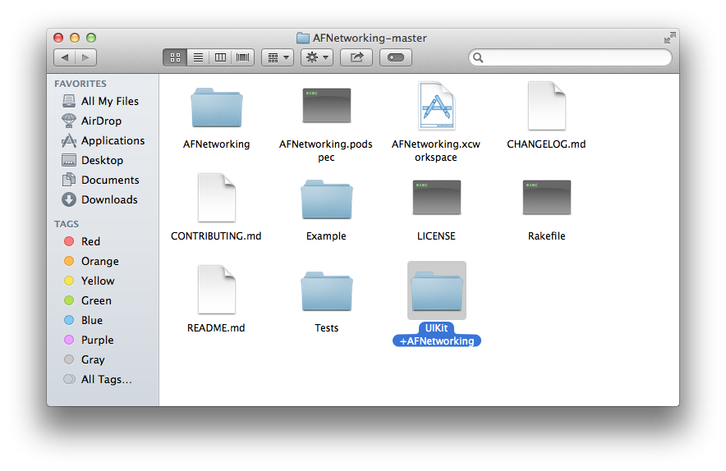
Image Download using UIKit extensions from AFNetworking
Adding the extensions to the program
Drag and drop to the project

Slide 22
Image Download using UIKit extensions from AFNetworking
Importing UIKit extensions from AFNetworking
#import "UIImageView+AFNetworking.h"
Downloading Image from ImageURL to ImageView
[_InstagramImage setImageWithURL:([NSURL URLWithString:urlnew]) ];
Method defined from the extension
URL of the Image

Slide 23

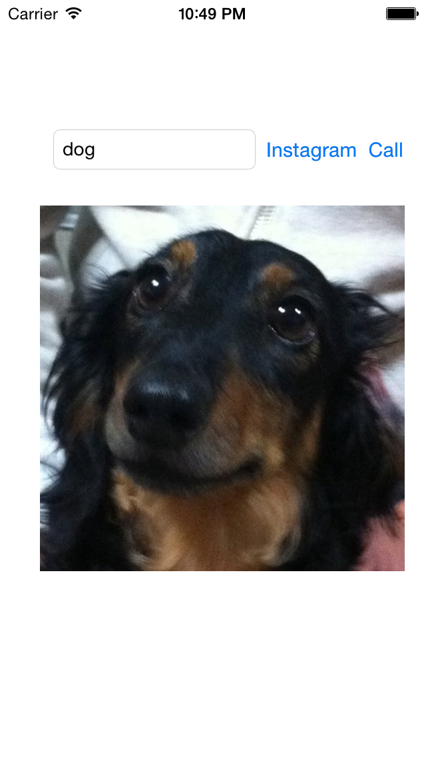
Final Run for Instagram Rest Service

Slide 24
Lab Assignment 2
Create a interactive iOS application using REST API.
Please mention the API you are asking.
Use an interesting idea for your application, it can also be the next step to your project.
Best Score would be for an interesting implementation for project related application.

Slide 25
References
Blocks concept
https://developer.apple.com/library/ios/documentation/Cocoa/Conceptual/ProgrammingWithObjectiveC/WorkingwithBlocks/WorkingwithBlocks.html
Objective-C Cheat Sheet
http://cdn1.raywenderlich.com/downloads/RW-Objective-C-Cheatsheet-v-1-5.pdf

Slide 26
Thank you

